Slide 1



XVIII Congreso Internacional ALASA 2025

Slide 2


La perspectiva del reasegurador
Presente y Futuro del Mercado del Reaseguro en América Latina
9 de Abril 2025
Elisabete Michel
Superintendente de Suscripción en Agricultura para Europa y América Latina
Munich Re
Germany

Slide 3
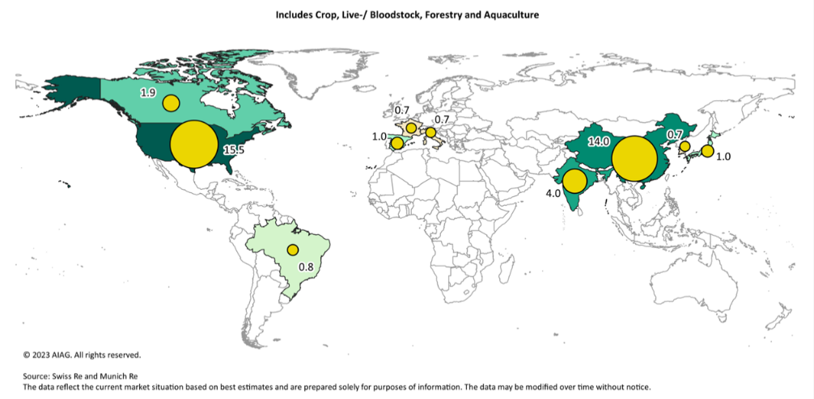
Top Ten Countries for Agriculture Insurance Premium in 2021 (in US$bn)

Slide 4
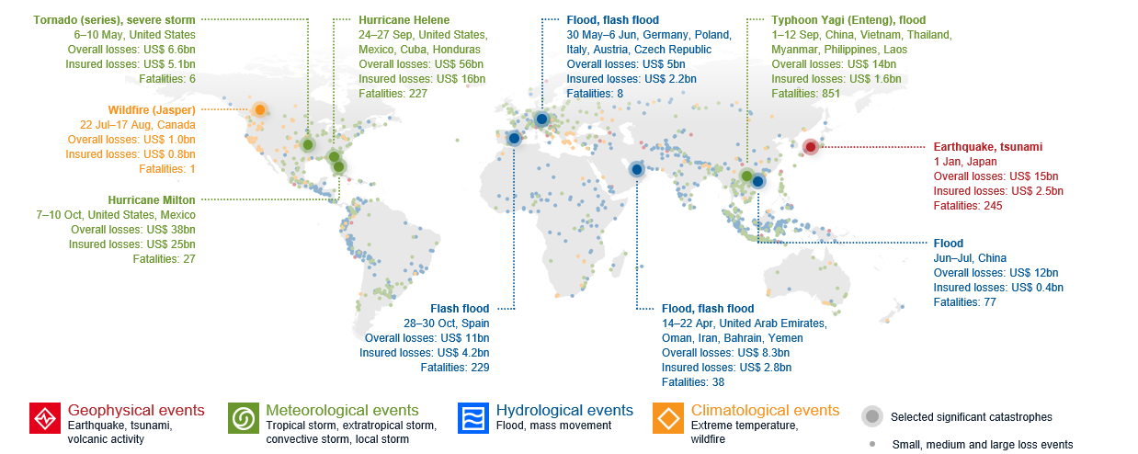
Natural Disaster loss events 2024
Natural catastrophes caused overall losses of US$ 320bn worldwide
© 2025 Münchener Rückversicherungs-Gesellschaft, NatCatSERVICE – As at January 2025

Slide 5
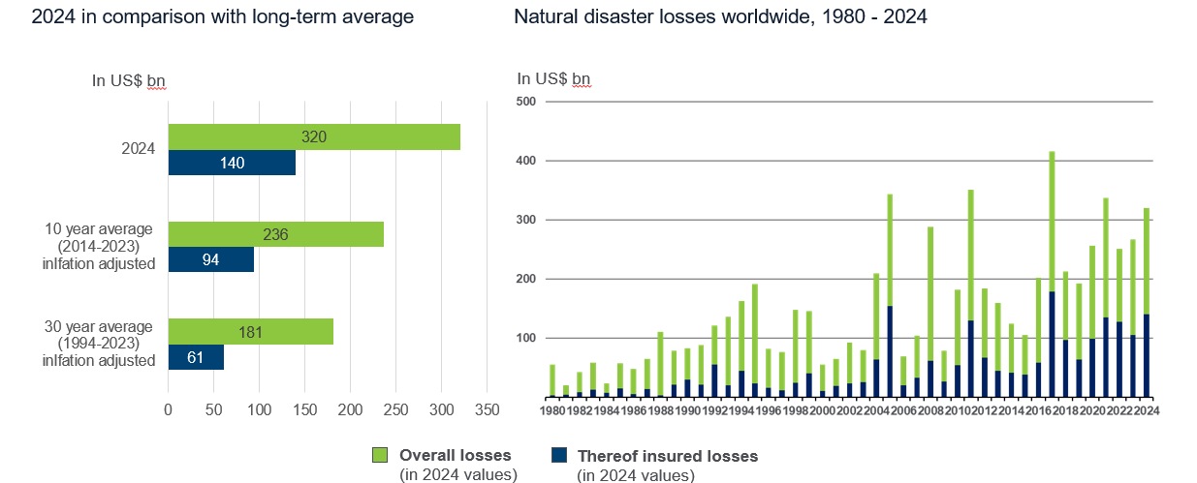
2024: 3rd costliest year for the insurance industry
US$ 100 bn insured loss years on the rise
© 2025 Münchener Rückversicherungs-Gesellschaft, NatCatSERVICE – As at January 2025

Slide 6


Slide 7

Obrigado!

